Slide 1

BASICS OF CIVIL ENGINEERING & MECHANICS
Course code:CV14/CV24
Credits:3:0:0
Topics Covered
Introduction to Civil Engineering

Slide 2

DEPARTMENT OF
CIVIL ENGINEERING
Course: Basics of Civil Engineering & Mechanics
Credits: 3:0:0
Introduction to Civil Engineering:
One of the oldest branch of engineering next to military engineering.
A Professional engineering discipline that deals with the analysis, design, construction and maintenance of infrastructural facilities such as building bridges, dams, roads etc.
Application of physical, mathematical and scientific principles for the convenience of civilization.
John Smeaton was the first self proclaimed Civil Engineer who built Eddystone Light House in 1771.

Slide 3


DEPARTMENT OF
CIVIL ENGINEERING
Course: Basics of Civil Engineering & Mechanics
Credits: 3:0:0
John Smeaton
John Smeaton Eddystone Lighthouse

Slide 4
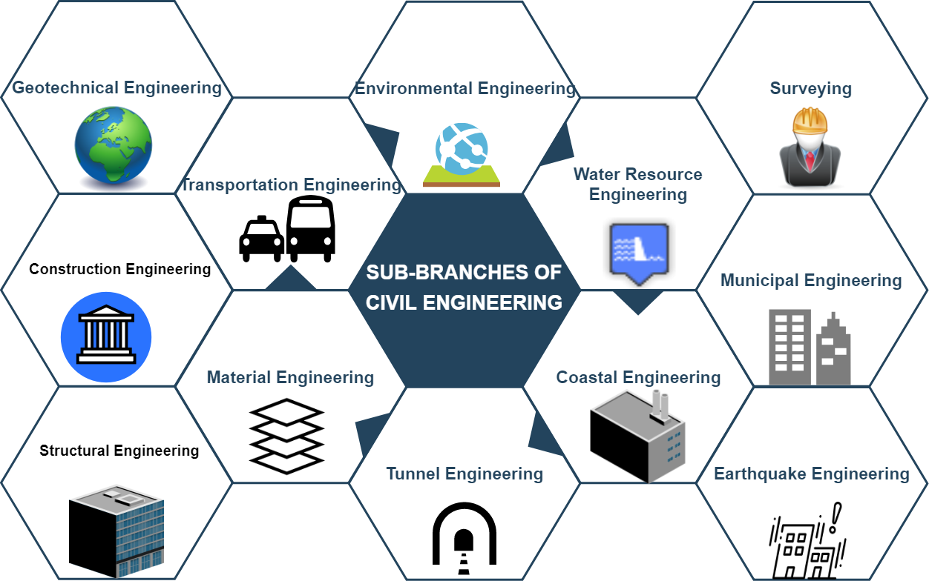
DEPARTMENT OF
CIVIL ENGINEERING
Course: Basics of Civil Engineering & Mechanics
Credits: 3:0:0
Broad Disciplines of Civil Engineering:

Slide 5
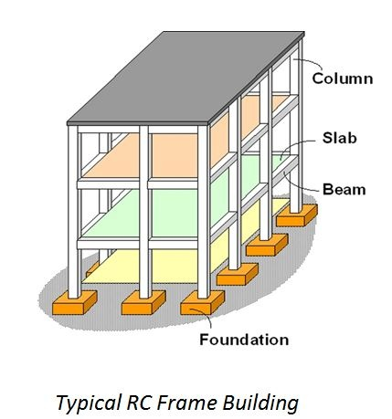
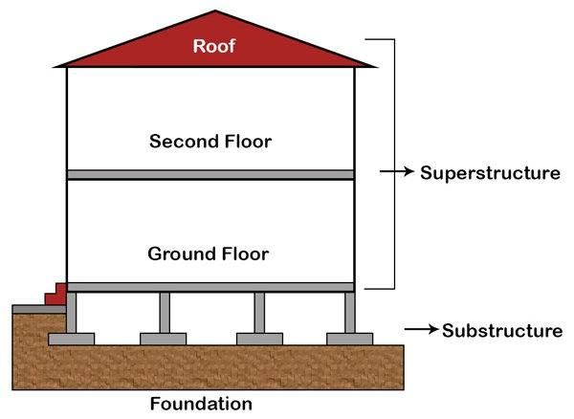
DEPARTMENT OF
CIVIL ENGINEERING
Course: Basics of Civil Engineering & Mechanics
Credits: 3:0:0
Components of Building:
Typical Building Elevation

Slide 6
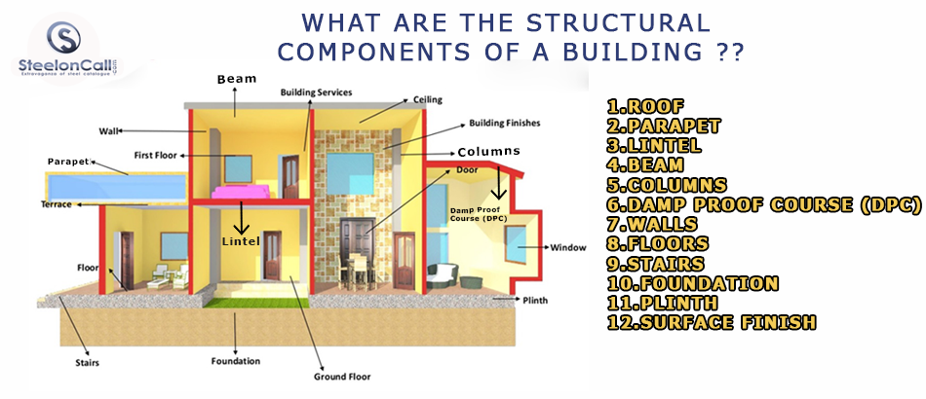
DEPARTMENT OF
CIVIL ENGINEERING
Course: Basics of Civil Engineering & Mechanics
Credits: 3:0:0
Components of Building:

Slide 7

DEPARTMENT OF
CIVIL ENGINEERING
Course: Basics of Civil Engineering & Mechanics
Credits: 3:0:0
Structural Engineering:
Structural engineering is the science and art of designing and making, with economy and elegance, buildings, bridges, frameworks and other structures so that they can safely resist the forces to which they may be subjected.
Structural Engineers plays a vital role in the planning, design, supervision, and implementation of a construction project for the structures to be materialized.

Slide 8
DEPARTMENT OF
CIVIL ENGINEERING
Course: Basics of Civil Engineering & Mechanics
Credits: 3:0:0
Responsibilities
Design structures, such as buildings or bridges.
Create structural models by using computer-aided design software.
Measure loads and pressures caused by environmental or human influence.
Follow construction safety guidelines.
Choose appropriate materials based on structural specifications.
Monitor on-site construction processes and supervise construction workers.

Slide 9
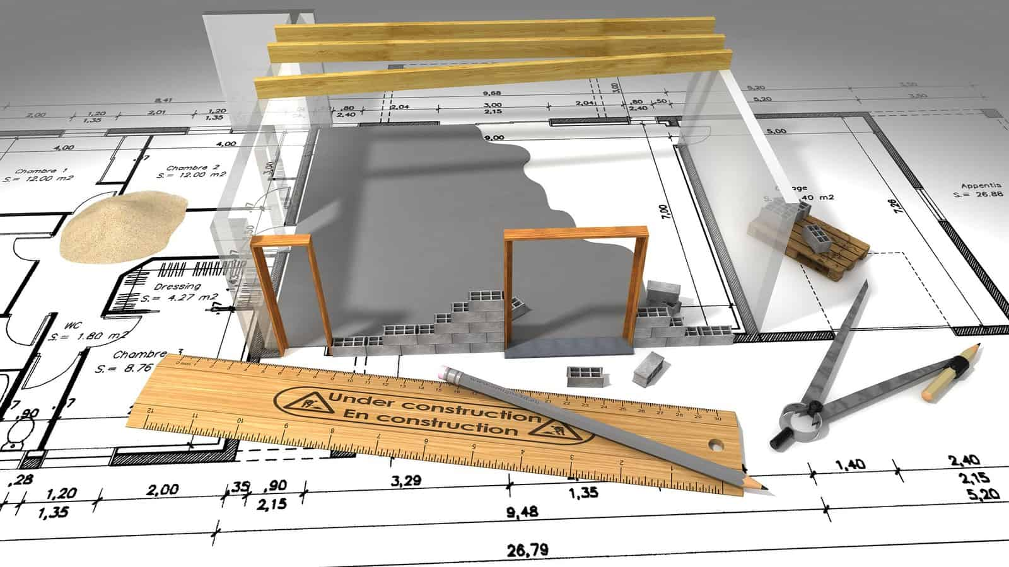
DEPARTMENT OF
CIVIL ENGINEERING
Course: Basics of Civil Engineering & Mechanics
Credits: 3:0:0
Prepare and allocate budgets.
Track and report on project progress
Collaborate with contractors and project managers .

Slide 10
DEPARTMENT OF
CIVIL ENGINEERING
Course: Basics of Civil Engineering & Mechanics
Credits: 3:0:0
GEOTECHNICAL ENGINEERING
Geotechnical Engineering is the study of rock and soil supporting Civil Engineering systems.
Identification of soil properties presents challenges to geotechnical engineers as the soil properties vary from place to place and with depth.
The material properties and behavior of soil are difficult to predict due to its variability and limitation on investigation.
It involves in the design of foundations, tunnels, embankments, dams, retaining walls, stability of natural slopes, mining, petroleum exploration, offshore structures, landfills etc.

Slide 11
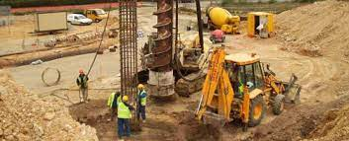

DEPARTMENT OF
CIVIL ENGINEERING
Course: Basics of Civil Engineering & Mechanics
Credits: 3:0:0
APPLICATIONS OF GEOTECHNICAL ENGINEERING
SITE INVESTIGATION AND FIELD TESTS TO ASSESS SOIL PROPERTIES

Slide 12
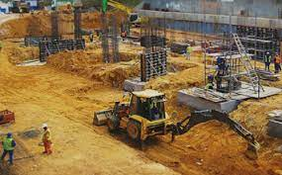
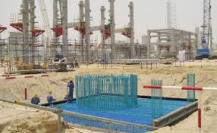
DEPARTMENT OF
CIVIL ENGINEERING
Course: Basics of Civil Engineering & Mechanics
Credits: 3:0:0
DESIGN OF FOUNDATIONS

Slide 13
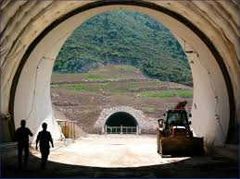
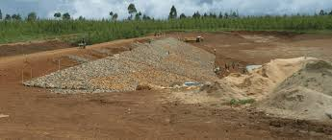
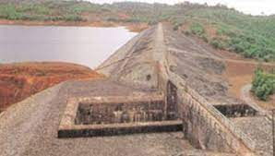
DEPARTMENT OF
CIVIL ENGINEERING
Course: Basics of Civil Engineering & Mechanics
Credits: 3:0:0
TUNNELS, EARTHEN EMBANKMENTS AND DAMS

Slide 14
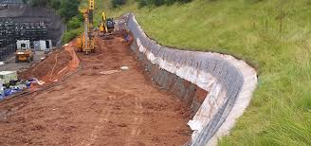
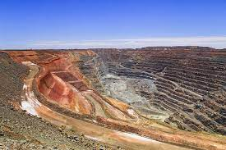
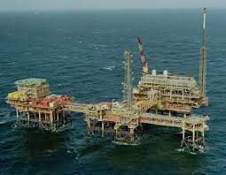

DEPARTMENT OF
CIVIL ENGINEERING
Course: Basics of Civil Engineering & Mechanics
Credits: 3:0:0
DESIGN OF RETAINING WALLS, SOIL SLOPES, MINING & FOUNDATIONS OF OFFSHORE STRUCTURES

Slide 15
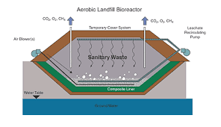
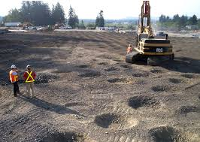
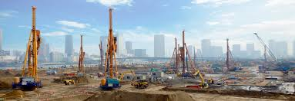
DEPARTMENT OF
CIVIL ENGINEERING
Course: Basics of Civil Engineering & Mechanics
Credits: 3:0:0
DESIGN OF LANDFILLS & GROUND IMPROVEMENT

Slide 16
DEPARTMENT OF
CIVIL ENGINEERING
Course: Basics of Civil Engineering & Mechanics
Credits: 3:0:0
HYDRAULICS ENGINEERING
Hydraulic engineering is the application of the principles of fluid mechanics to problems dealing with the collection, storage, control, transport, regulation, measurement, and use of water.
The widespread applications of hydraulics in civil engineering include transportation of fluids in pipes and in open channels, as well as flow measurement for both pipes and open channels.
A Hydraulic engineer design the hydraulic structures such as dams, levees, water distribution networks including both domestic and fire water supply, storm water management, water collection networks etc..

Slide 17
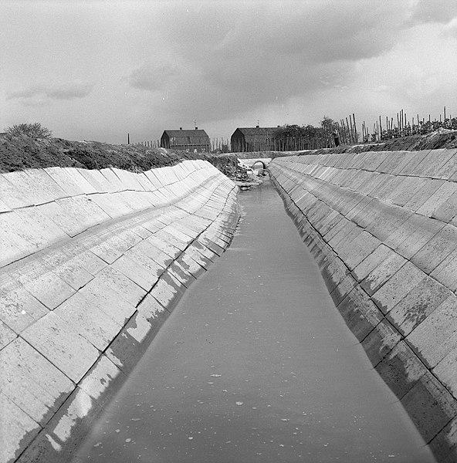
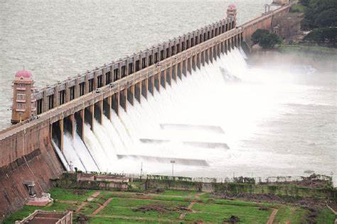
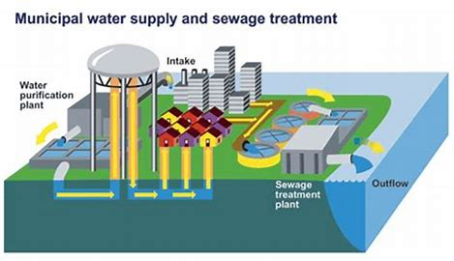
DEPARTMENT OF
CIVIL ENGINEERING
Course: Basics of Civil Engineering & Mechanics
Credits: 3:0:0

Slide 18
DEPARTMENT OF
CIVIL ENGINEERING
Course: Basics of Civil Engineering & Mechanics
Credits: 3:0:0
WATER RESOURCES ENGINEERING
Water Resources Engineering is the quantitative study of the hydrologic cycle. It is concerned with the collection and management of water (as a natural resource).
As a discipline it therefore combines elements of hydrology, environmental science, meteorology, conservation and resource management.
This area of Civil Engineering relates to the prediction and management of both the quality and quantity of water in both ground and surface water resources.
Applications include the management of the urban water supply, the design of urban storm – sewer systems, flood forecasting, design of hydraulic structures, irrigation systems etc.

Slide 19
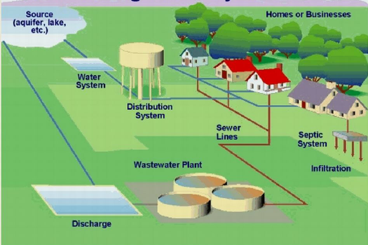
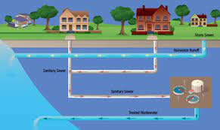
APPLICATIONS OF WATER RESOURCES ENGINEERING
DEPARTMENT OF
CIVIL ENGINEERING
Course: Basics of Civil Engineering & Mechanics
Credits: 3:0:0
WATER SUPPLY SYSTEM
SEWER SYSTEM
DESIGN OF WATER SUPPLY AND SEWER SYSTEMS

Slide 20
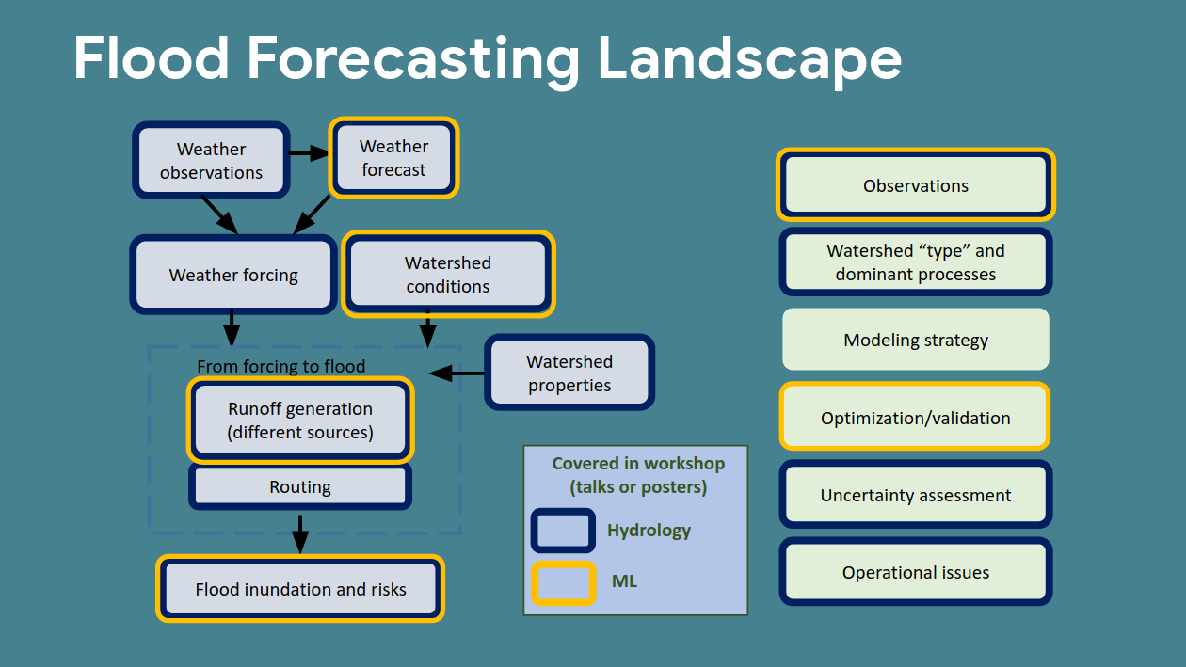
DEPARTMENT OF
CIVIL ENGINEERING
Course: Basics of Civil Engineering & Mechanics
Credits: 3:0:0
FLOOD FORECASTING

Slide 21
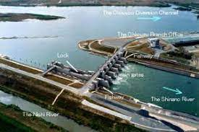
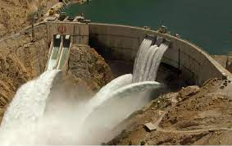

DEPARTMENT OF
CIVIL ENGINEERING
Course: Basics of Civil Engineering & Mechanics
Credits: 3:0:0
DESIGN OF HYDRAULIC STRUCTURES

Slide 22
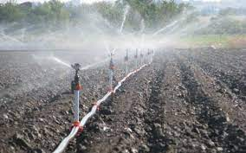
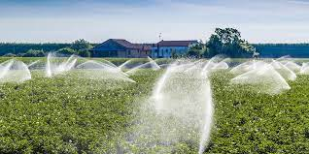
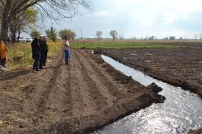
DEPARTMENT OF
CIVIL ENGINEERING
Course: Basics of Civil Engineering & Mechanics
Credits: 3:0:0
DESIGN OF IRRIGATION SYSTEMS

Slide 23
DEPARTMENT OF
CIVIL ENGINEERING
Course: Basics of Civil Engineering & Mechanics
Credits: 3:0:0
Transportation Engineering
Transportation engineering is a sub discipline of Civil engineering and is essentially defined as applying technology and science principles in order to plan, create functional designs, operate and manage facilities which pertain to any mode of transportation. The goals include safe, efficient, rapid, convenient, comfortable, economical and environmentally acceptable movement of goods and people.

Slide 24
DEPARTMENT OF
CIVIL ENGINEERING
Course: Basics of Civil Engineering & Mechanics
Credits: 3:0:0
Branches of Transportation Engineering
1. Highway engineering
2. Railroad engineering
3. Port and harbour engineering
4. Airport engineering
Role of Transportation Engineer:
To develop the various Transportation strategies for the efficient movement of Traffic.
To plan, design, and develop the transportation systems, which include traffic signal systems.
To develop and maintain traffic systems and processes.

Slide 25
DEPARTMENT OF
CIVIL ENGINEERING
Course: Basics of Civil Engineering & Mechanics
Credits: 3:0:0
To prepare the administrative-technical and statistical reports on the traffic operations.
To integrate safety procedures and Standards in transport operations.
To evaluate the traffic control devices and determine the need of its modification and expansion.
Importance of the Transportation Engineering:
Transportation helps in the economic, social, and commercial development of the nation.
Transportation also helps in the cultural as well as political development of the country.

Slide 26
DEPARTMENT OF
CIVIL ENGINEERING
Course: Basics of Civil Engineering & Mechanics
Credits: 3:0:0
Transportation improves the import and export of the country and helps in the industrial development throughout the nation.
Transportation has to connect two countries or areas with each other and improve the employment opportunities

Slide 27

DEPARTMENT OF
CIVIL ENGINEERING
Course: Basics of Civil Engineering & Mechanics
Credits: 3:0:0
Classification of Roads:
Based on location and function as
National Highway(NH)-Yellow and White
State Highway(SH)-Green and white
Major District Roads(MDR)-Black and white
Other District Roads(ODR)
Village Roads (VR)

Slide 28
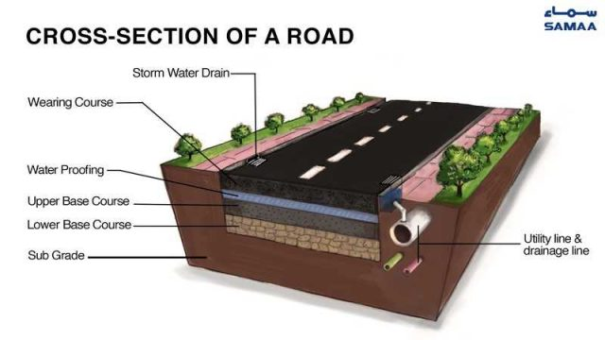
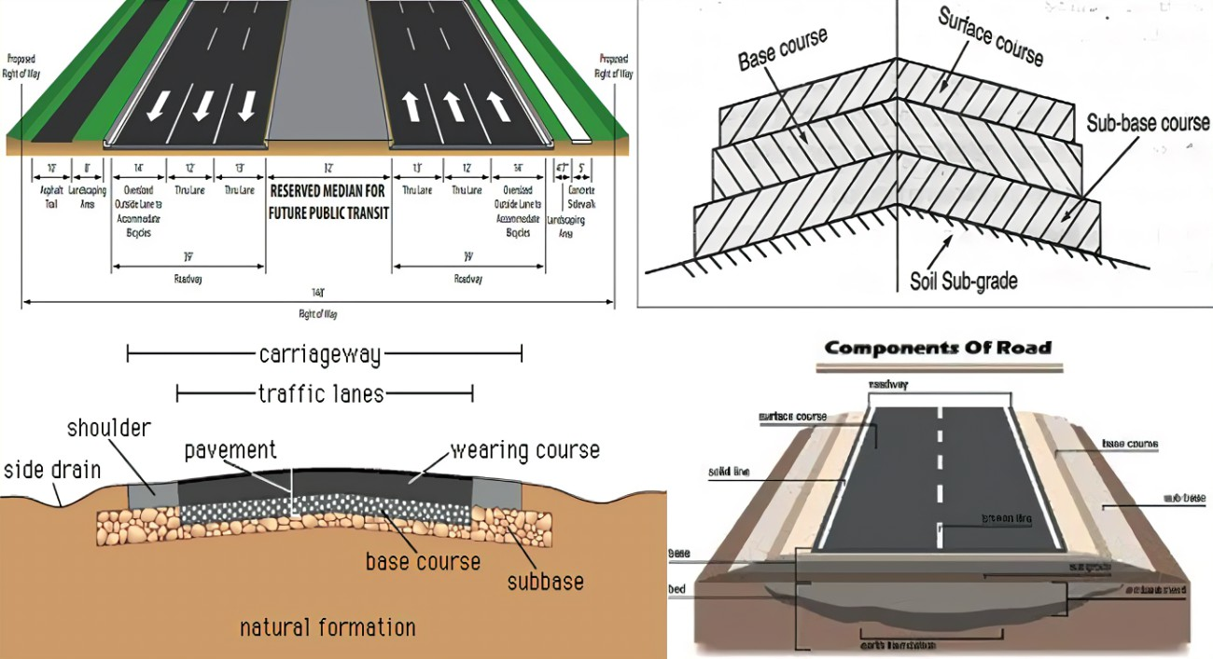
DEPARTMENT OF
CIVIL ENGINEERING
Course: Basics of Civil Engineering & Mechanics
Credits: 3:0:0

Slide 29
DEPARTMENT OF
CIVIL ENGINEERING
Course: Basics of Civil Engineering & Mechanics
Credits: 3:0:0
ENVIRONMENTAL ENGINEERING
It involves waste management, waste disposal systems, pollution control, environmental sustainability, public health, water supply and treatment, waste water treatment, water resources management, air pollution management, pollutant transport, hazardous waste management etc.
Applications include quantification of different types of pollutants, fixing standards for effluents, monitoring / prevention of different types of pollution, environmental impact assessment for factories and industries, conservation and preservation of natural resources and environment, design and construction of pipe lines etc.

Slide 30
DEPARTMENT OF
CIVIL ENGINEERING
Course: Basics of Civil Engineering & Mechanics
Credits: 3:0:0
ENVIRONMENTAL ENGINEERING
Environmental engineering also deals with the remediation of contaminated sites after waste disposal or accidental contamination.
Environmental engineers administer pollution reduction, green engineering, industrial ecology and compile information on environmental consequences of proposed actions.

Slide 31
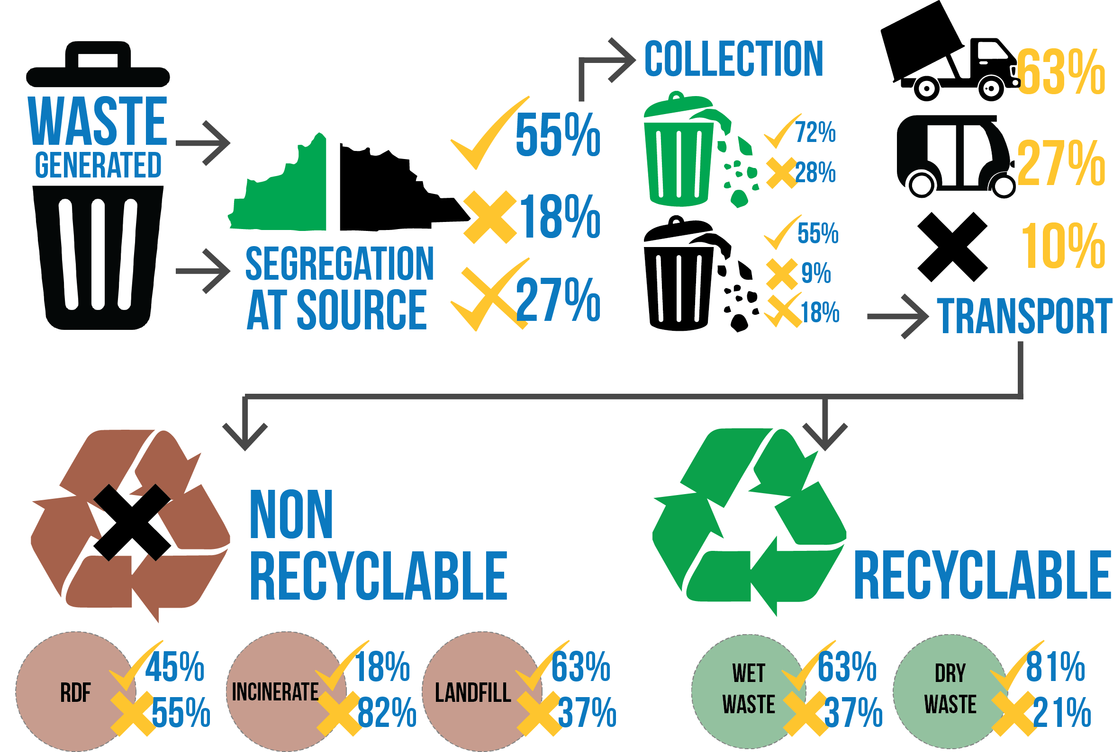
APPLICATIONS OF ENVIRONMENTAL ENGINEERING
DEPARTMENT OF
CIVIL ENGINEERING
Course: Basics of Civil Engineering & Mechanics
Credits: 3:0:0
WASTE MANAGEMENT

Slide 32
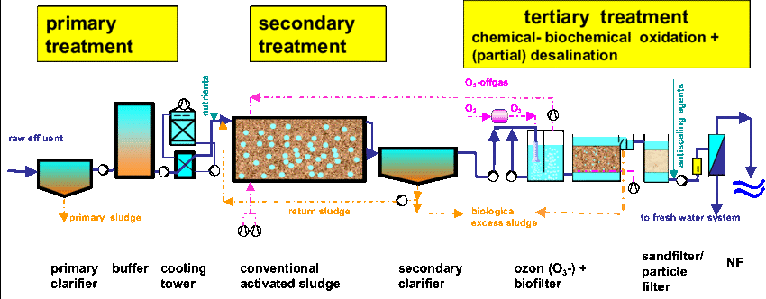
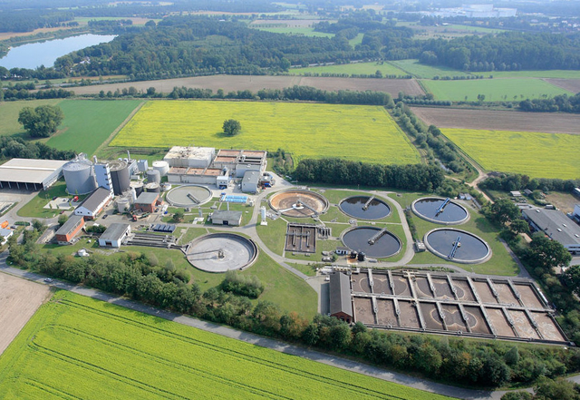
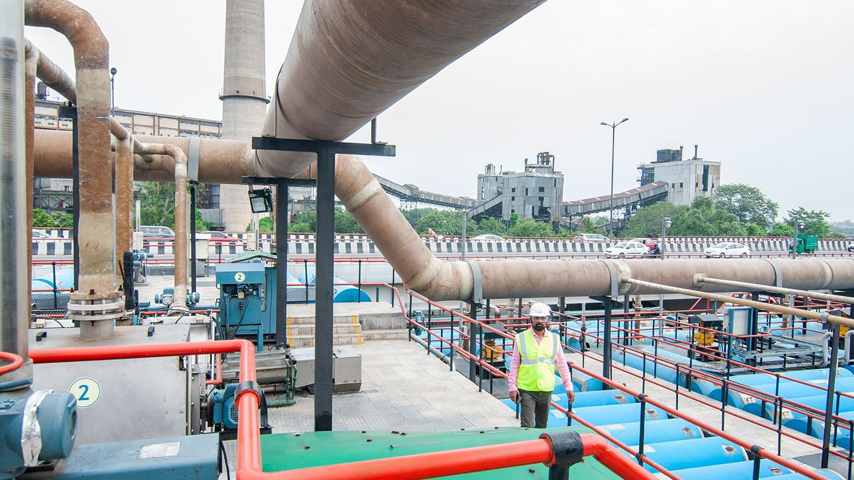
DEPARTMENT OF
CIVIL ENGINEERING
Course: Basics of Civil Engineering & Mechanics
Credits: 3:0:0
WASTE WATER TREATMENT

Slide 33
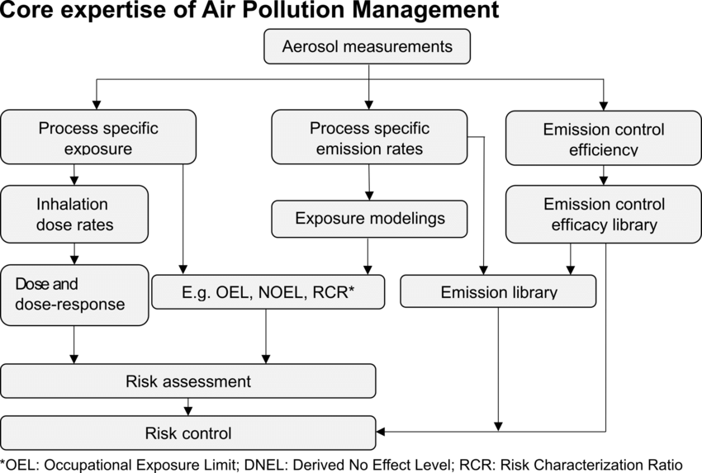
DEPARTMENT OF
CIVIL ENGINEERING
Course: Basics of Civil Engineering & Mechanics
Credits: 3:0:0
AIR POLLUTION MANAGEMENT

Slide 34
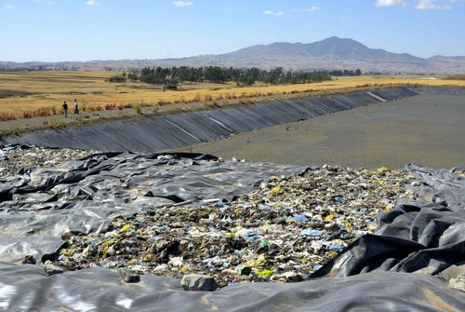
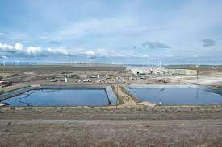
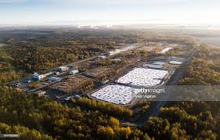
DEPARTMENT OF
CIVIL ENGINEERING
Course: Basics of Civil Engineering & Mechanics
Credits: 3:0:0
HAZARDOUS WASTE MANAGEMENT

Slide 35
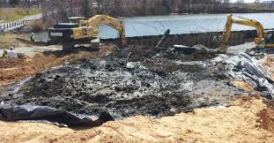
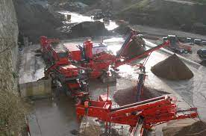
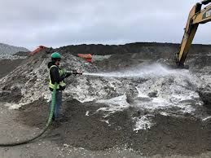
DEPARTMENT OF
CIVIL ENGINEERING
Course: Basics of Civil Engineering & Mechanics
Credits: 3:0:0
REMEDIATION OF CONTAMINATED SITES

Slide 36
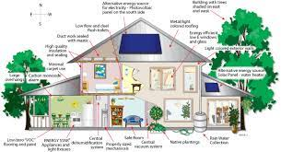
DEPARTMENT OF
CIVIL ENGINEERING
Course: Basics of Civil Engineering & Mechanics
Credits: 3:0:0
GREEN BUILDING TECHNIQUES

Slide 37

Construction Planning and Management
Planning, scheduling is an important part of the construction management. Planning and scheduling of construction activities helps engineers to complete the project in time and within the budget.
The term ‘Construction’ does not only denotes physical activities involving men, materials and machinery but also covers the entire gamut of activities from conception to realization of a construction project. Thus, management of resources such as men, materials, machinery requires effective planning and scheduling of each activity.

Slide 38
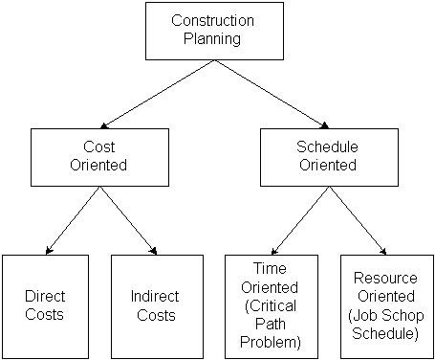
Construction Planning and Management

Slide 39
What is Construction Management?
Management is the science and art of planning, organizing, leading and controlling the work of organization members and of using all available organization resources to reach stated organizational goals. Construction management deals with economical consumption of the resources available in the least possible time for successful completion of construction project. ‘Men’, ‘materials’, ‘machinery’ and ‘money’ are termed as resources in construction Management.

Slide 40
Objectives of Construction Management:
Prepare and negotiate cost estimates, budgets, and work timetables
Select appropriate construction methods and strategies
Interpret and explain contracts and technical information to workers and other professionals
Report on work progress and budget matters to clients

Slide 41
Objectives of Construction Management:
Collaborate with architects, engineers, and other construction and building specialists
Instruct and supervise construction personnel and activities onsite
Respond to work delays and other problems and emergencies
Select, hire, and instruct laborers and subcontractors
Comply with legal requirements, building and safety codes, and other regulations

Slide 42
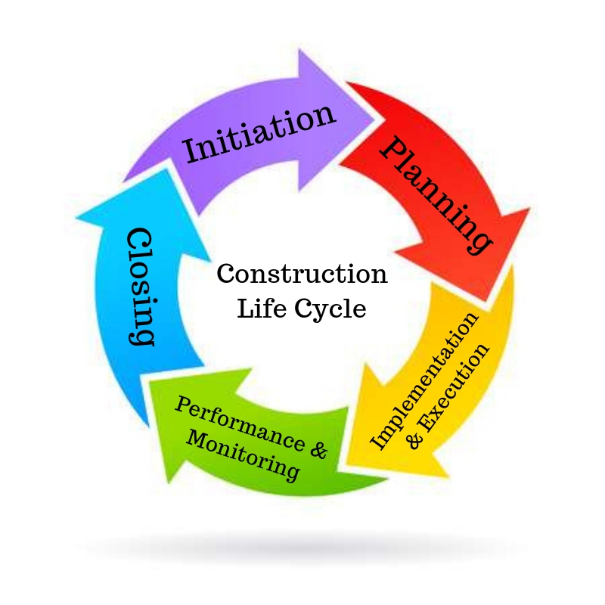

Slide 43
Functions of Construction Management:
The functions of construction Management are
(a) Planning
(b) Scheduling
(c) Organizing
(d) Staffing
(e) Directing
(f) Controlling
(g) Coordinating

Slide 44
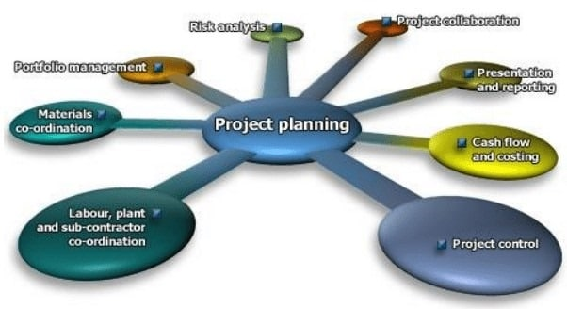
Planning in Construction Management:
It is the process of selecting a particular method and the order of work to be adopted for a project from all the possible ways and sequences in which it could be done. It essentially covers the aspects of ‘What to do’ and ‘How to do it’.

Slide 45
Planning helps to minimize the cost by optimum utilization of available resources, reduces irrational approaches, duplication of works and inter departmental conflicts. It encourages innovation and creativity among the construction managers.
b) Scheduling in Construction Management:
Scheduling is the fitting of the final work plan to a time scale. It shows the duration and order of various construction activities. It deals with the aspect of ‘when to do it’.

Slide 46
c) Organizing:
Organizing is concerned with decision of the total construction work into manageable departments/sections and systematically managing various operations by delegating specific tasks to individuals.
d) Staffing:
Staffing is the provision of right people to each section department created for successful completion of a construction project.

Slide 47

e) Directing: It is concerned with training sub ordinates to carryout assigned tasks, supervising their work and guiding their efforts. It also involves motivating staff to achieve desired results.
f) Controlling: It involves a constant review of the work plan to check on actual achievements and to discover and rectify deviation through appropriate corrective measures.

Slide 48

g) Coordinating:
It involves bringing together and coordinating the work of various departments and sections so as to have good communication. It is necessary for each section to aware of its role and the assistance to be expected from others.

